Slide 1
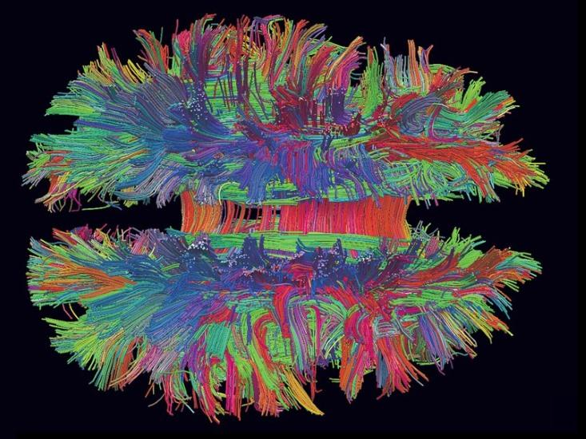
The Neuroscience of Emotions Part 1
Sangeeta Das Bhattacharya MD,MPH
School of Medical Science and Technology IIT Kharagpur

Slide 2
4 Principles
Part 1

Slide 3
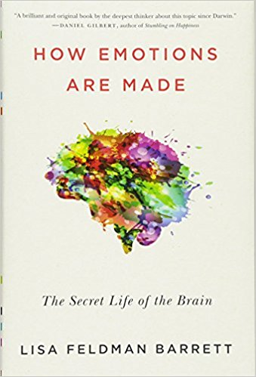
Lisa Feldman Barrett
University Distinguished Professor Northeastern

Slide 4
Which question should we ask?
Where are the happiness neurons?
How does the brain construct the experience of happiness?

Slide 5
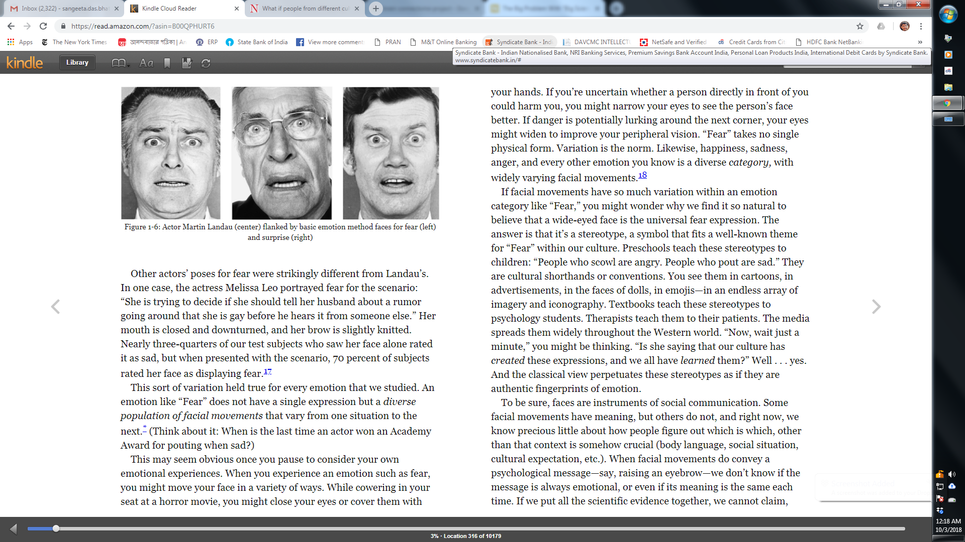

Slide 7
Does a brain region contain the fingerprint for a single emotion?

Slide 8

Urbach-Wiethe Disease
-identical twin studies

Slide 9
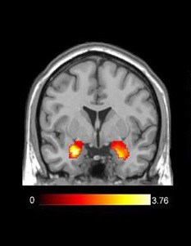
The Amygdala
Amydala-
Studies show increased firing in the amygdala in studies about fear

Slide 10
Amydala-
But also in anger, disgust, sadness, happiness, also when you learn something new, meet new people, make decisions

Slide 11
No
Does a brain region contain the fingerprint for a single emotion?

Slide 12
Principles of Neuroscience
Principle 1: Degeneracy
A mental event is not created by one set of neurons.
Combinations of different neurons create an experience.

Slide 13
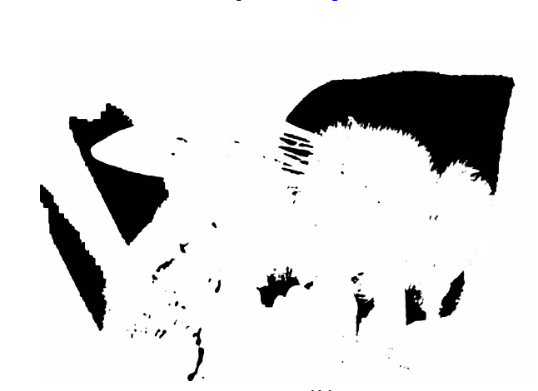

Slide 14
Experiential Blindness

Slide 15


Slide 16
Principles of Neuroscience
Principle 2 : Simulation
Simulation is the default mode for all mental activity. It is your brain’s guesses of what is happening in the world.

Slide 17
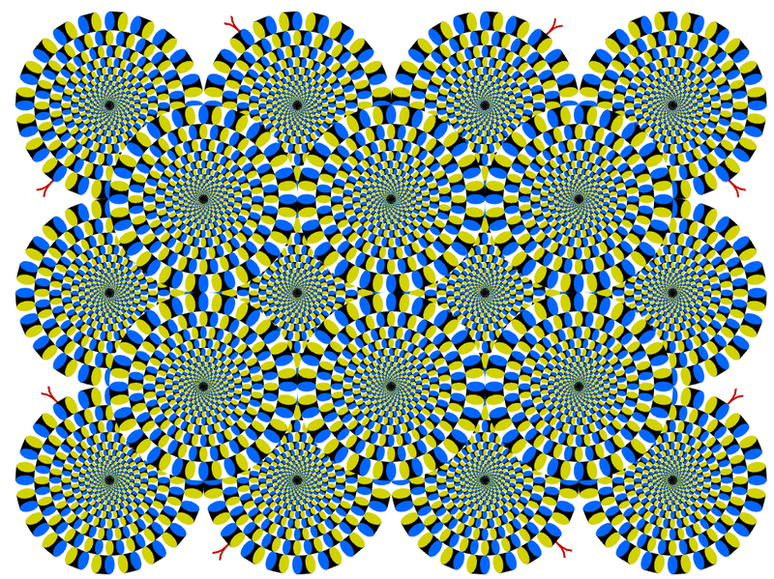

Slide 18
Rotating Snakes
Akiyoshi Kitaoka Professor of Psychology Ritusmeikan University, Kyoto Japan, http://www.ritsumei.ac.jp/~akitaoka/index-e.html

Slide 19



Slide 20

Hachinoko

Slide 21


Hachinoko

Slide 22
Principles of Neuroscience
Principle 3 : Concepts
Your brain uses concepts which are based on experiences to simulate or guess the meaning of incoming sensory input

Slide 23


Slide 24


Slide 25

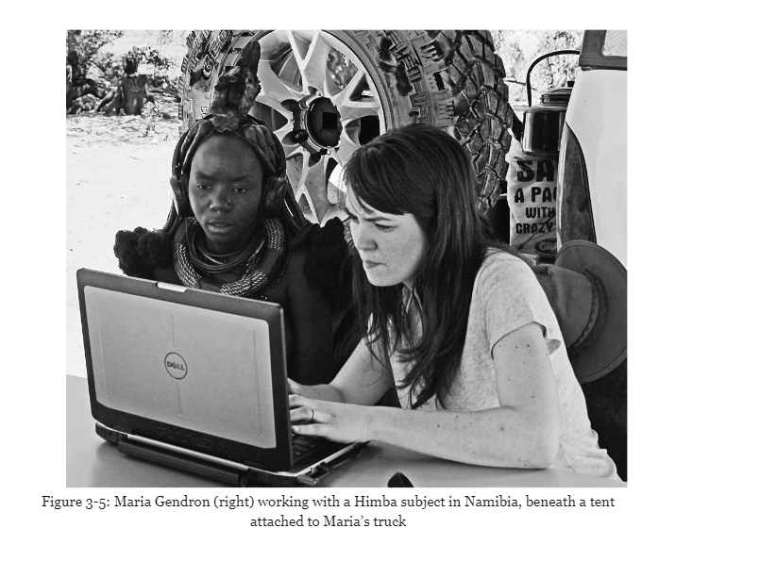
Are emotional perceptions universal?

Slide 26
Principles of Neuroscience
Principle 4 : Prediction
Your brain is constantly predicting.
Intrinsic brain activity is millions and millions of nonstop predictions.

Slide 27
